Slide 1
Text-to-Image Synthesis with a Custom Deep Convolutional GAN
01001000 01101001
Hi!
By Stavroula Tsoni
By Vasilis Tsavalias
Notes:
template: Slidesgo “Artificial Intelligence”

Slide 2

01
Introduction

Slide 3
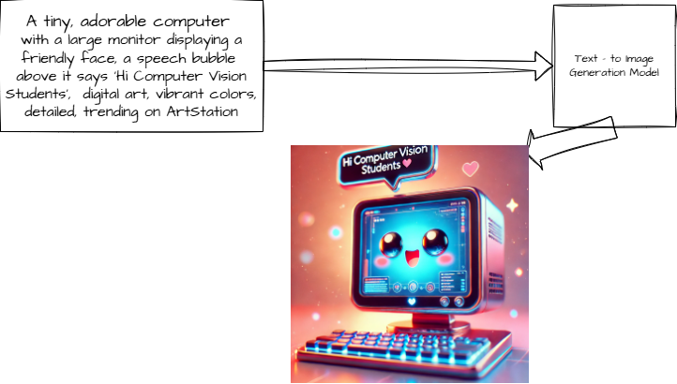
What is Text-to-image generation?
Notes:
Created by DALL-E

Slide 4
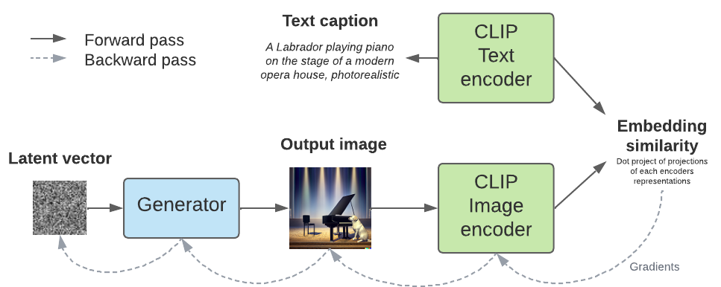
A closer inspection….

Slide 5
02
Dataset Selection & Exploration

Slide 6
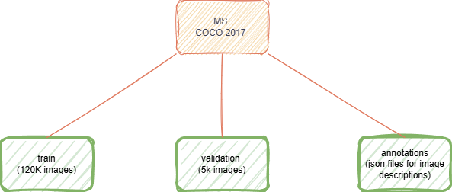


Slide 7
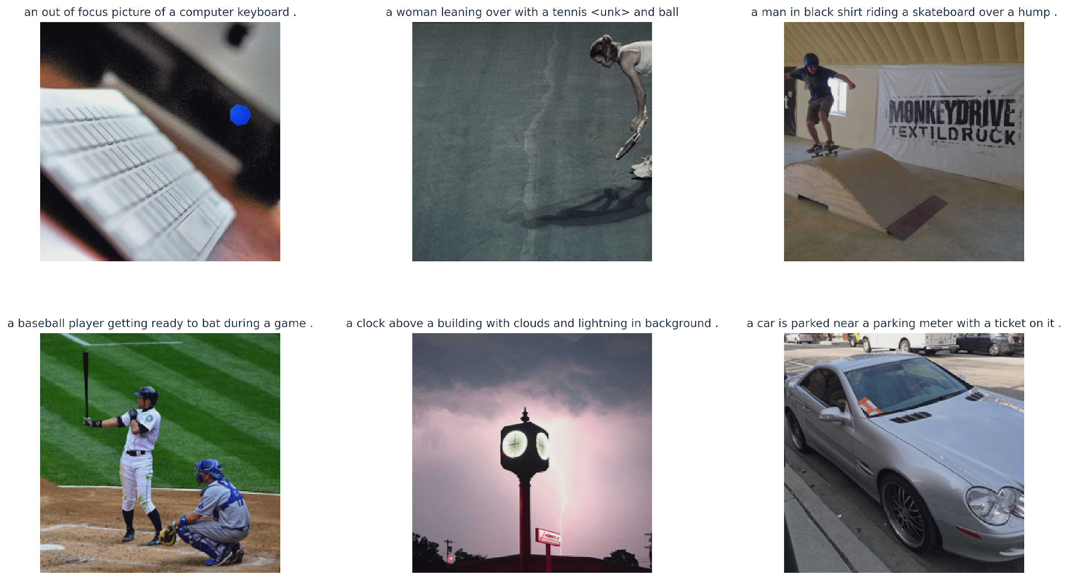

Slide 8
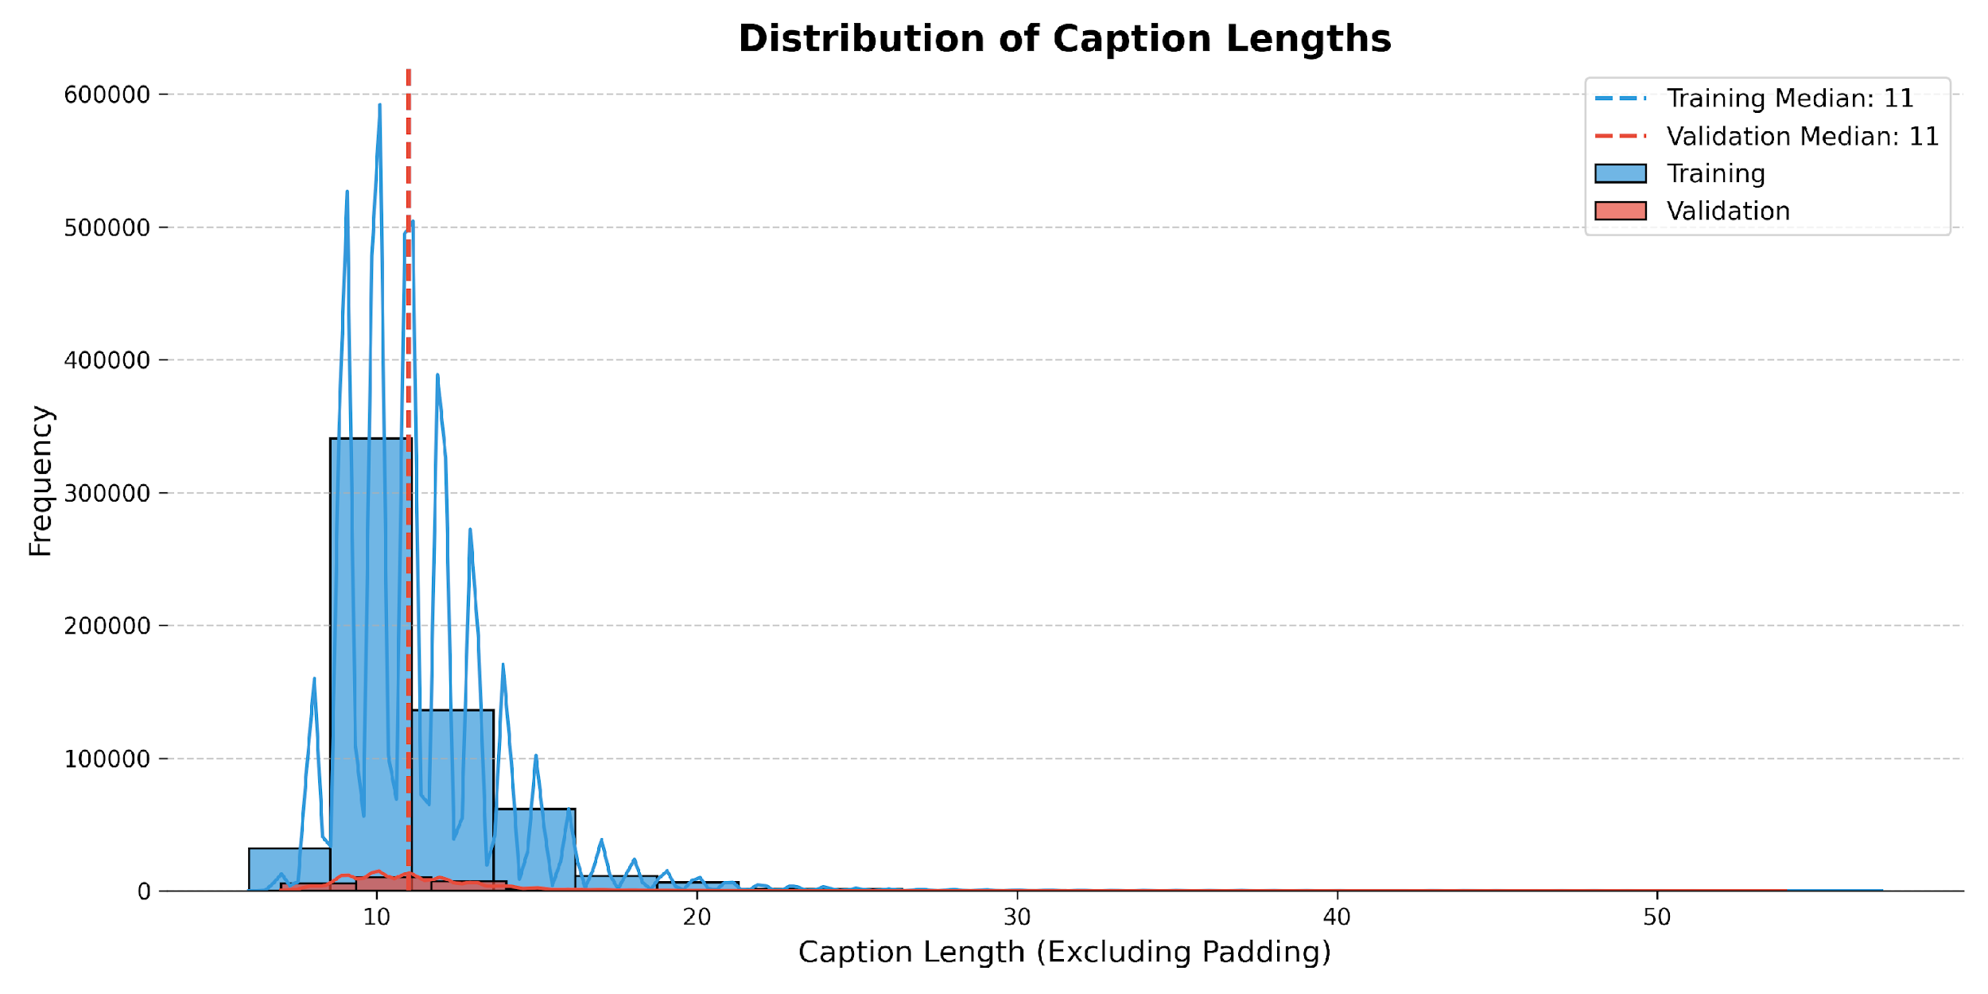

Slide 9
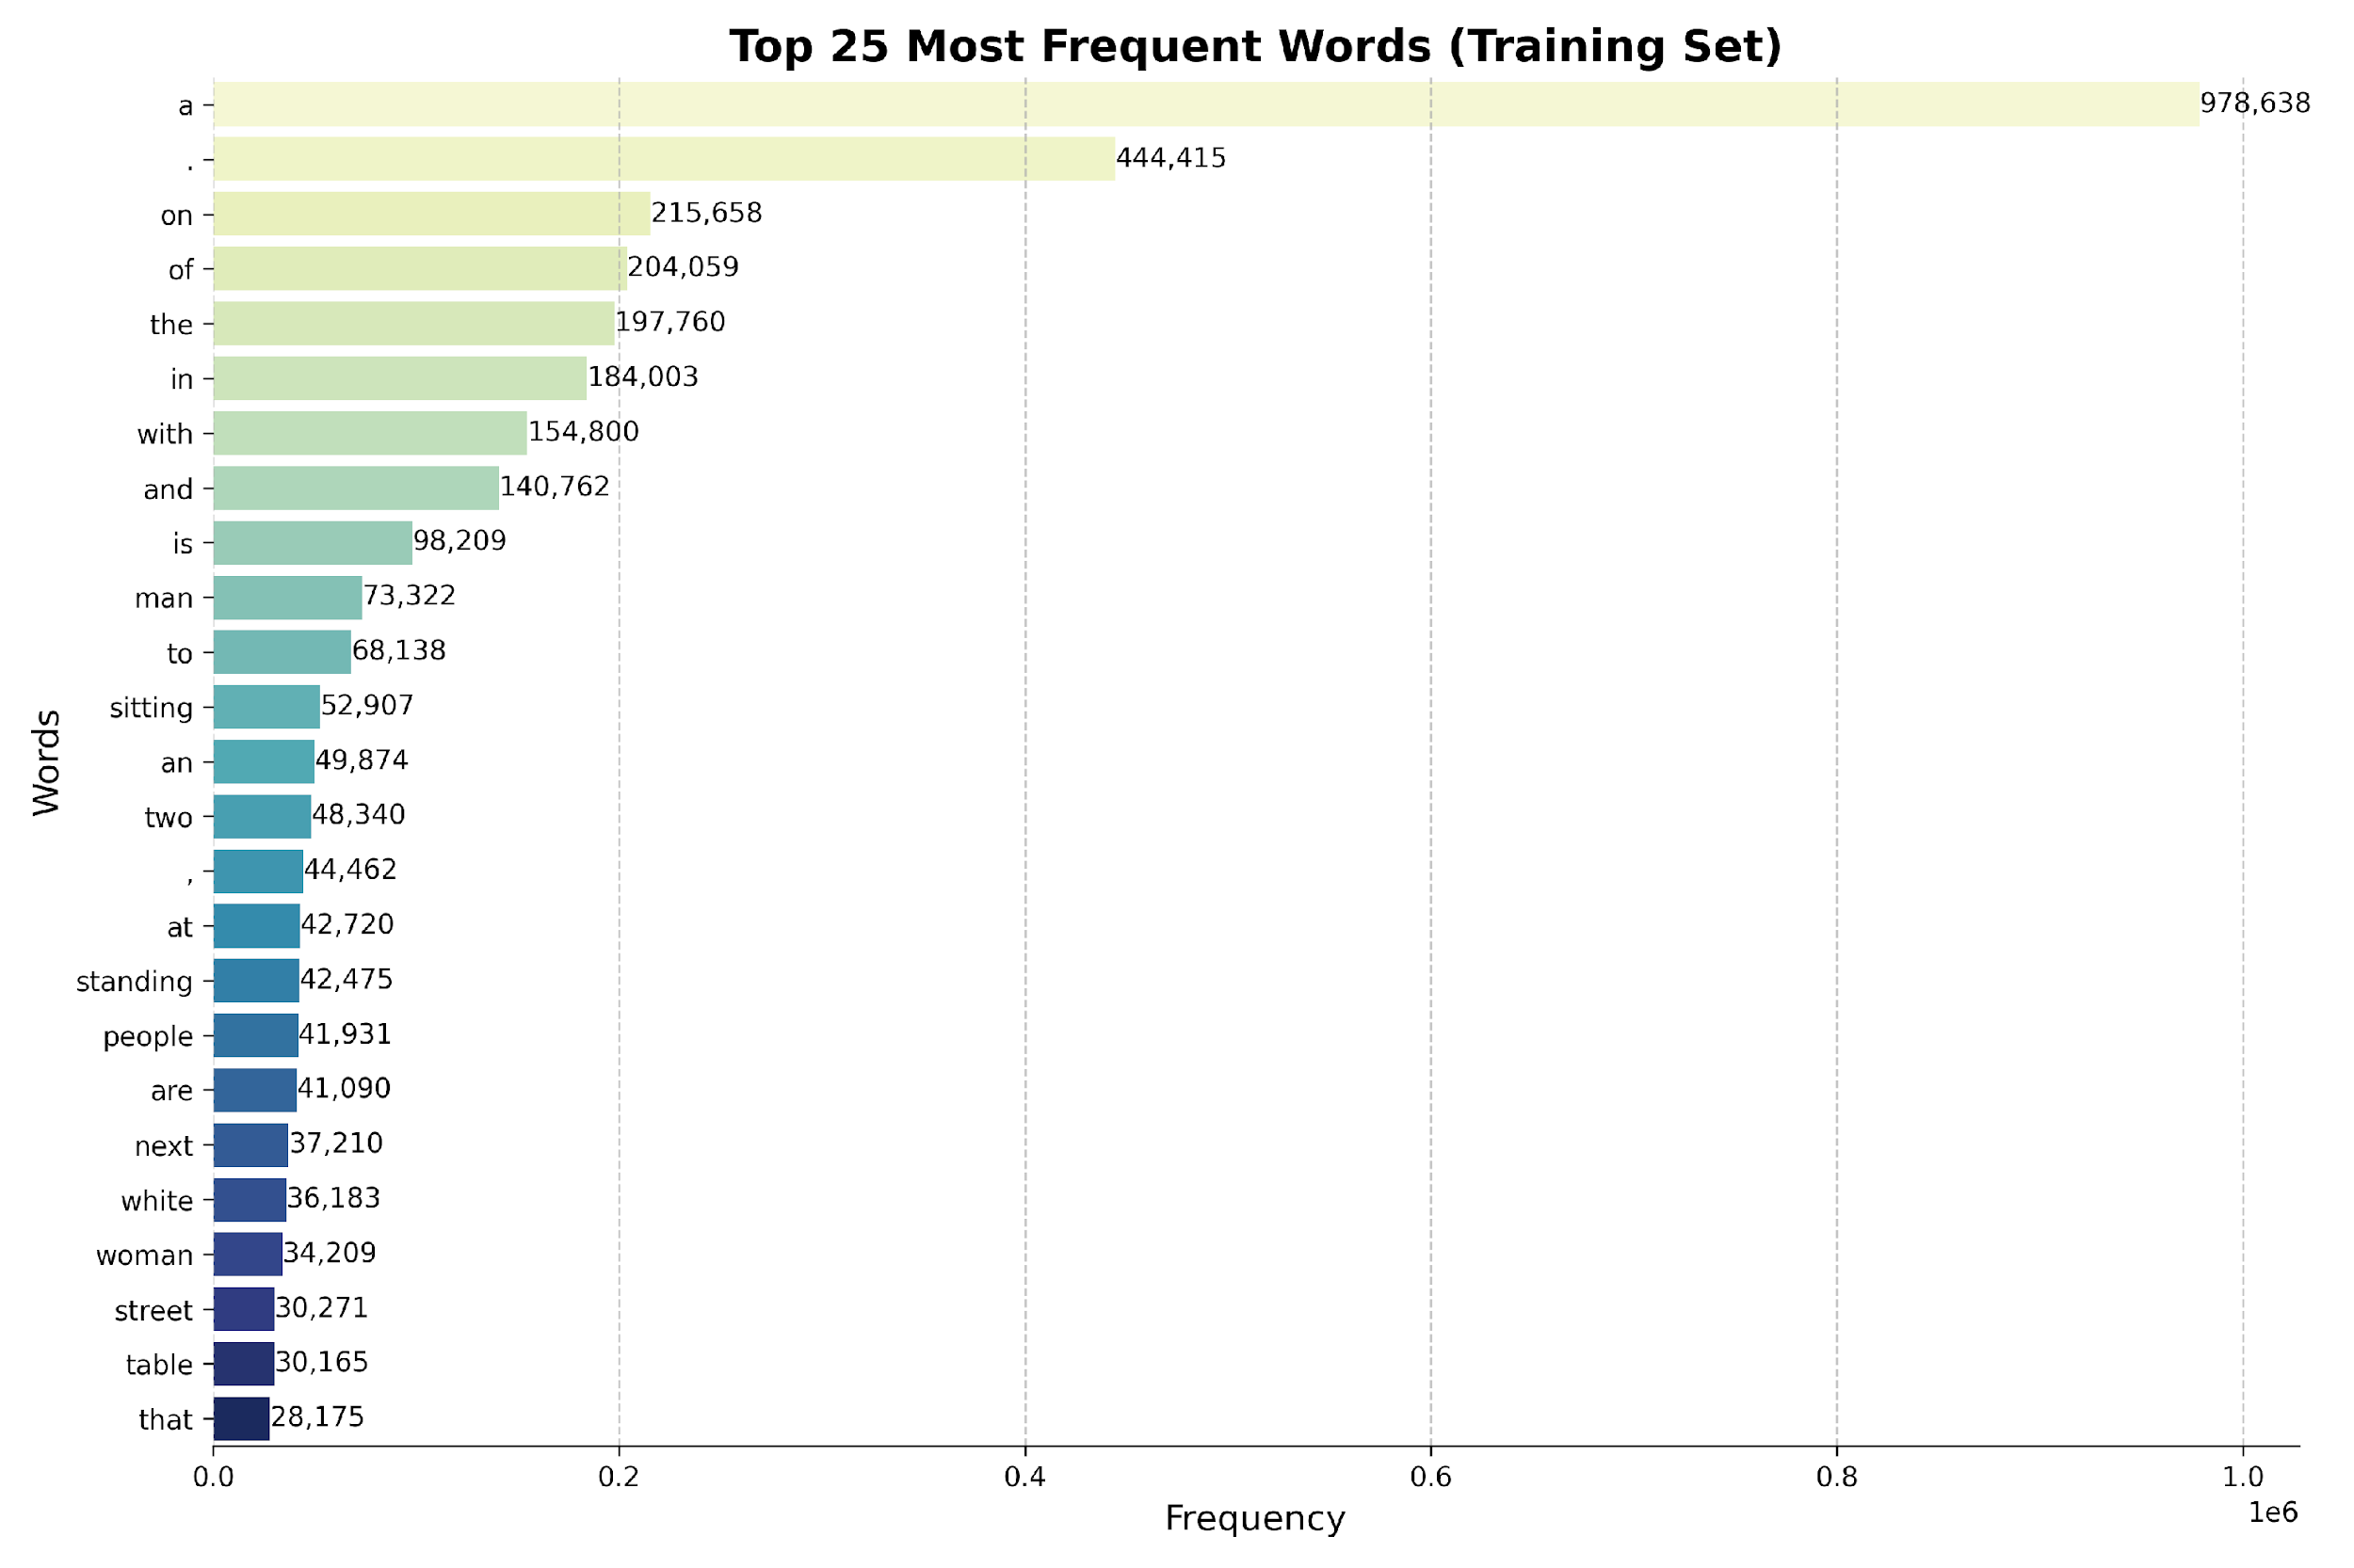

Slide 10
03
Model Architecture (DCGAN)

Slide 11
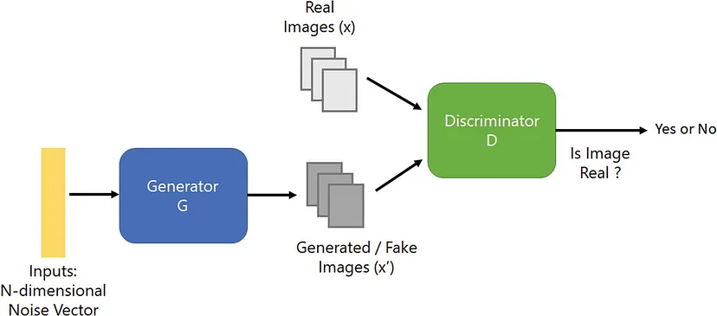
A simple GAN architecture

Slide 12
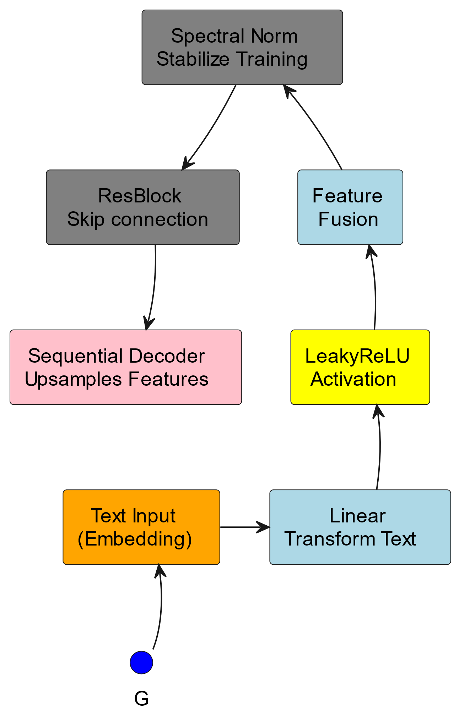
Our GAN implementation - Generator

Slide 13
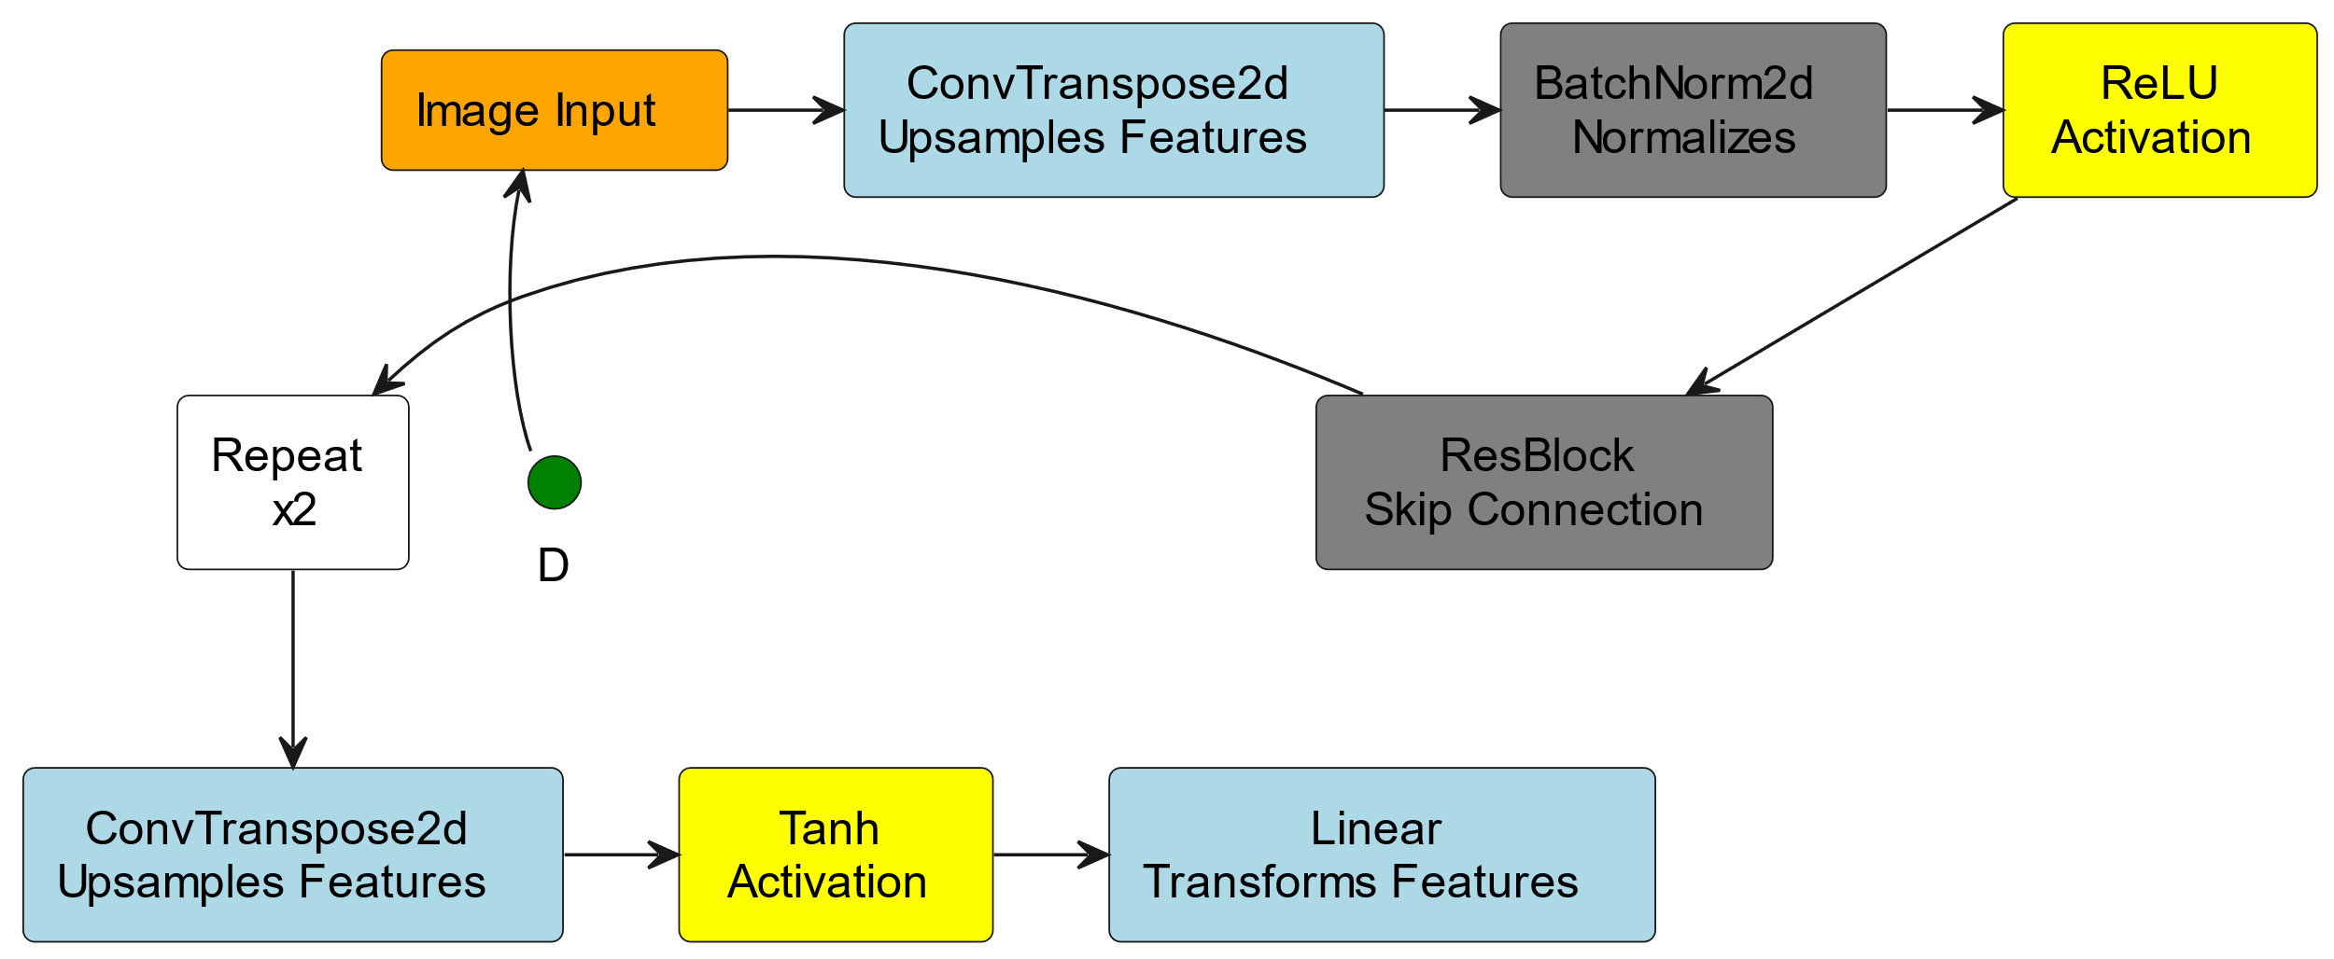
Our GAN implementation - Discriminator

Slide 14
04
Workflow & Limitations

Slide 15
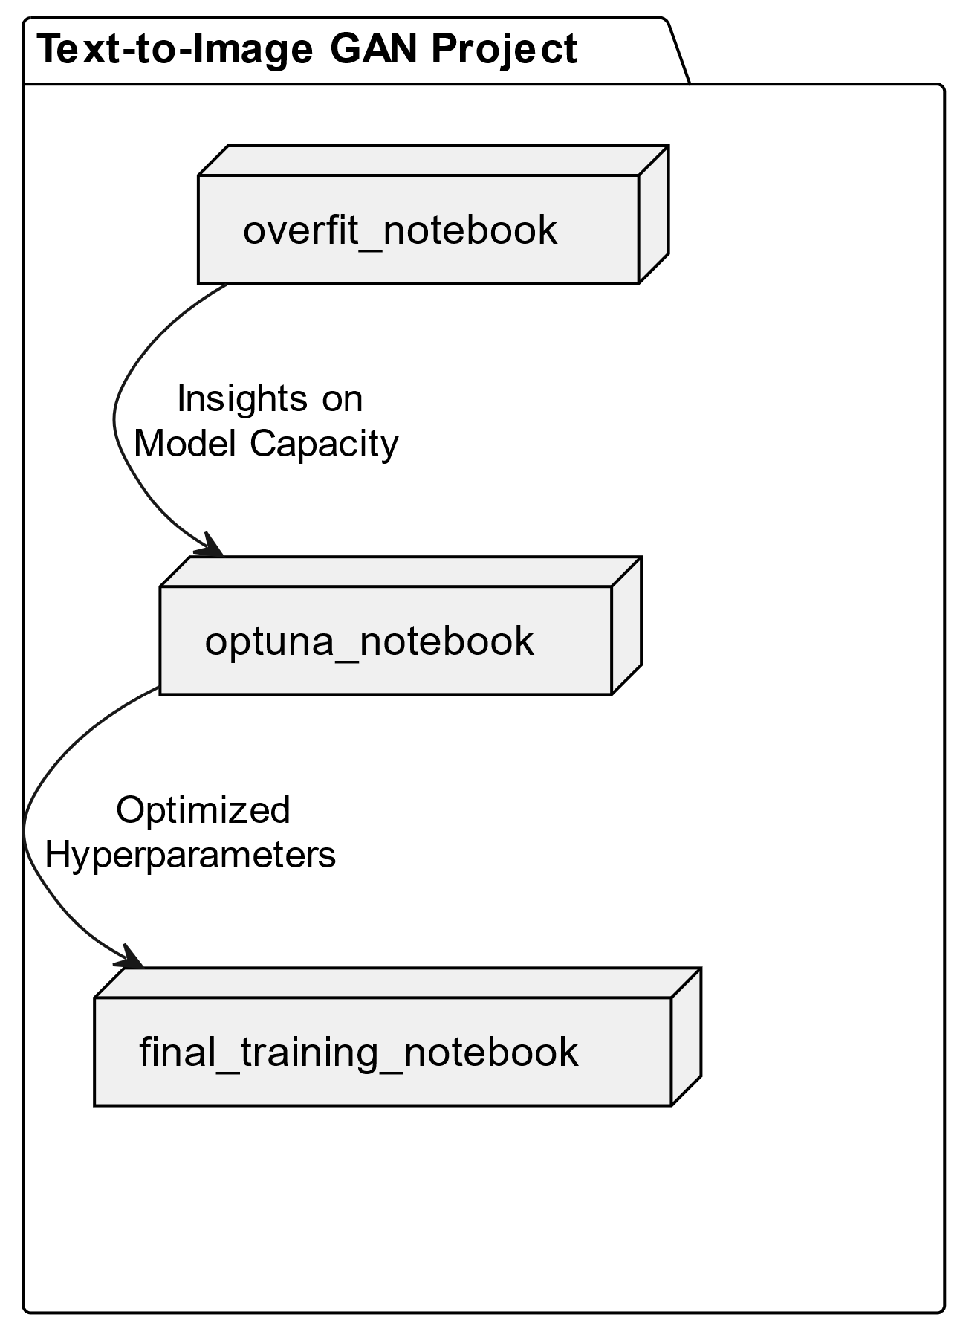

Slide 16
Part 1: Technical Limitations - Limited VRAM on Kaggle (16GB)
Reduced Image Resolution:
Downscaled to 224x224 pixels, losing critical fine-grained details.
2. Inability to Capture Important Metrics :
Loading InceptionV3 for score calculation caused memory errors.
FID was computationally infeasible due to VRAM constraints
3. Restricted Model Architectures:
Forced use of a smaller DCGAN with limited layers and filters.
Incapable of Loading any pre-trained Diffusion or GAN models
4. Pre-loaded CLIP model:
Additional VRAM was consumed,
restricting model size further.

Slide 17
Part 2: Technical Limitations - Kaggle Session Duration
Fragmented Workflow:
Project split into 3 notebooks:
Reduced reproducibility and slowed iterations.
2. Slow GPU training:
Training took ~30 minutes per epoch due to memory bottlenecks.
Limited feasible epochs within session durations.
3. Limited Training Epochs:
Maximum of 6-20 epochs, leading to underfitting, low convergence.
Insufficient time for thorough training.
4. Lackluster Cross-Validation:
5-fold cross-validation affected evaluation robustness.

Slide 18
05
Results

Slide 19
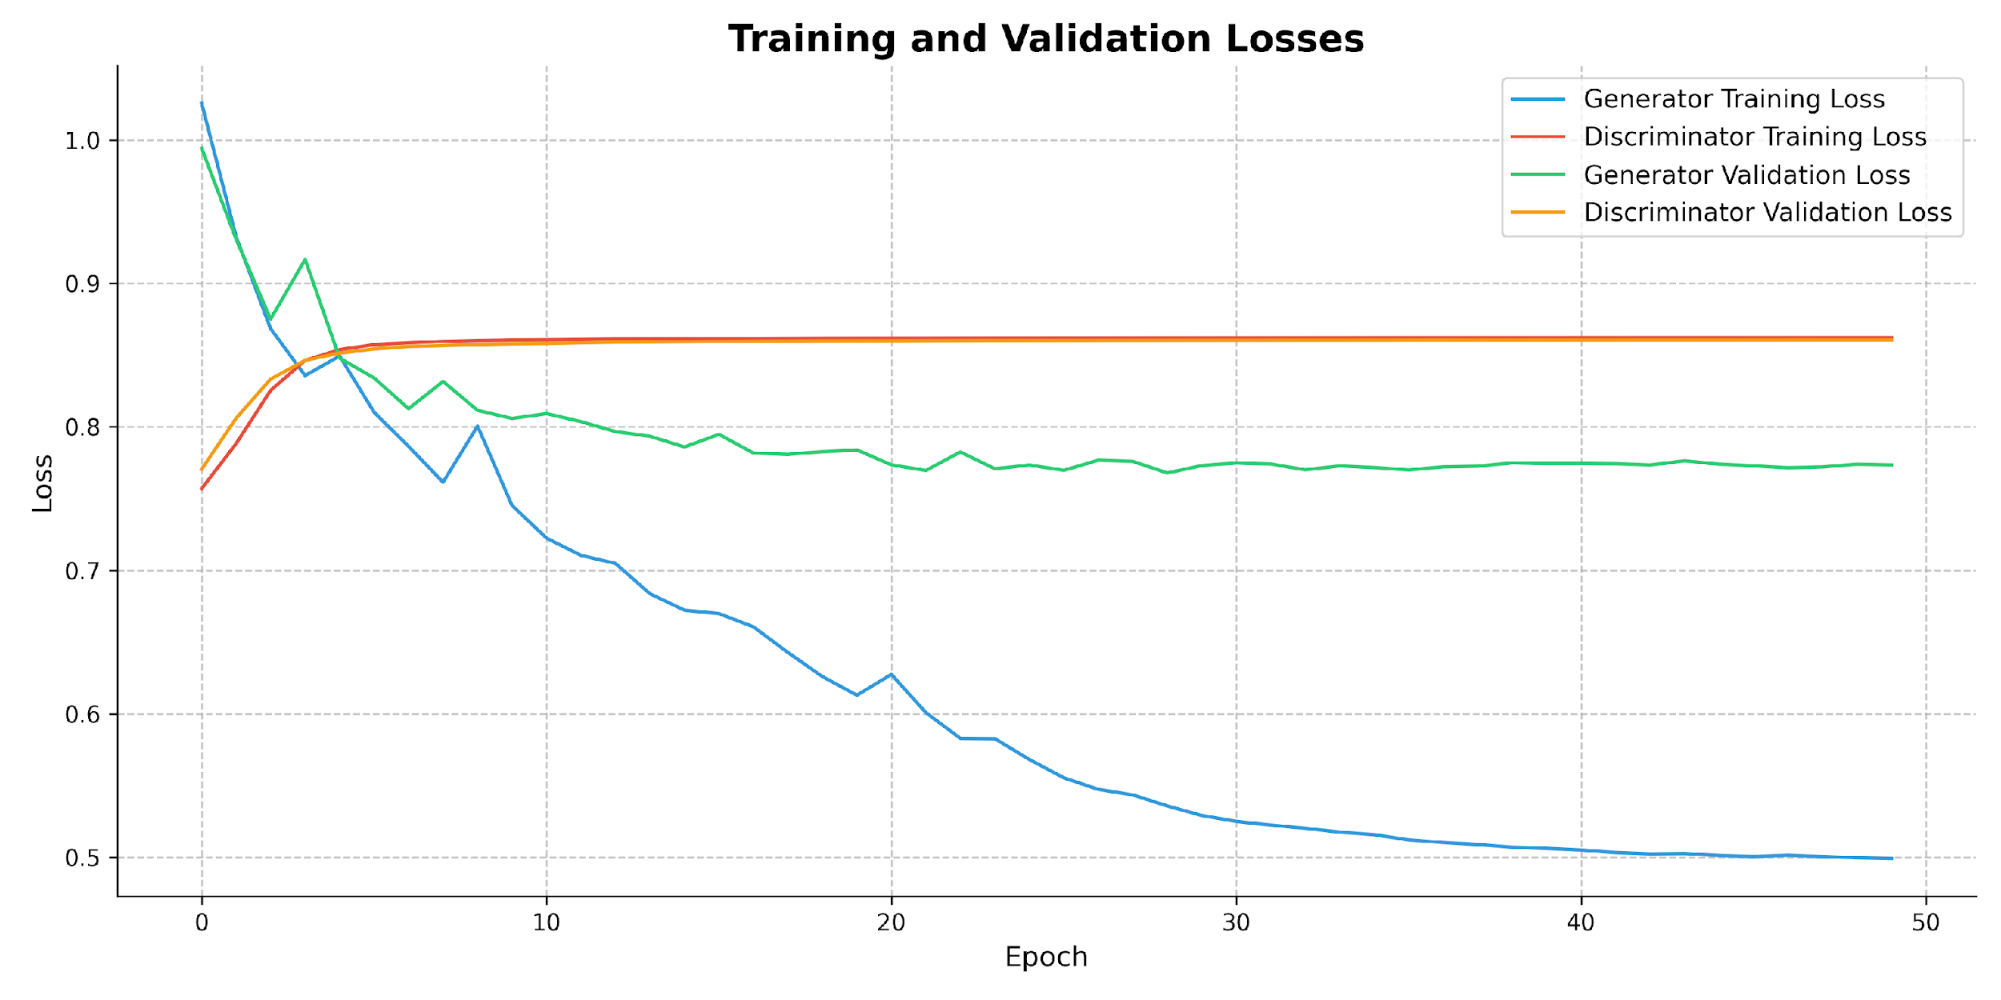
Ζούμε στην εποχή των δεδομένων
Notes:
Δυο φορες το gdp της ελλαδας.

Slide 20
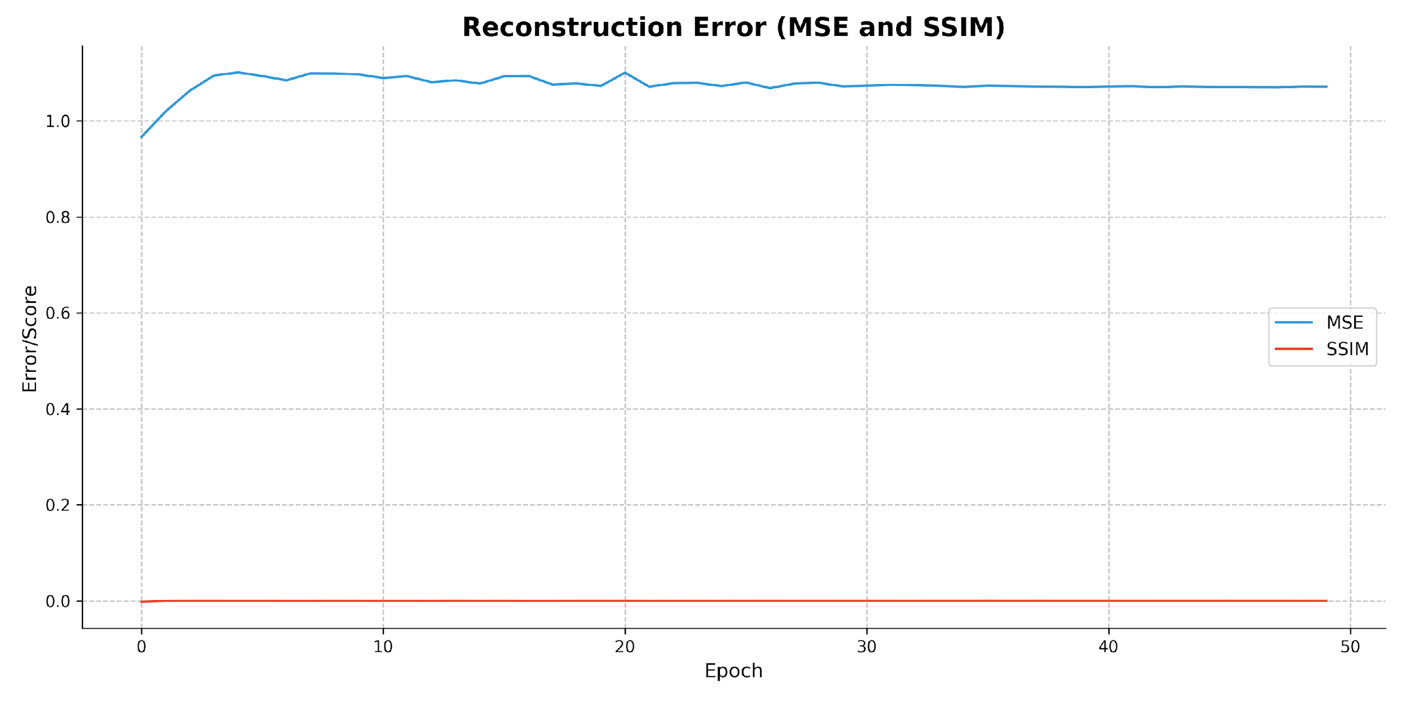
Notes:
GDP γερμανίας 4.4 trillion.

Slide 21
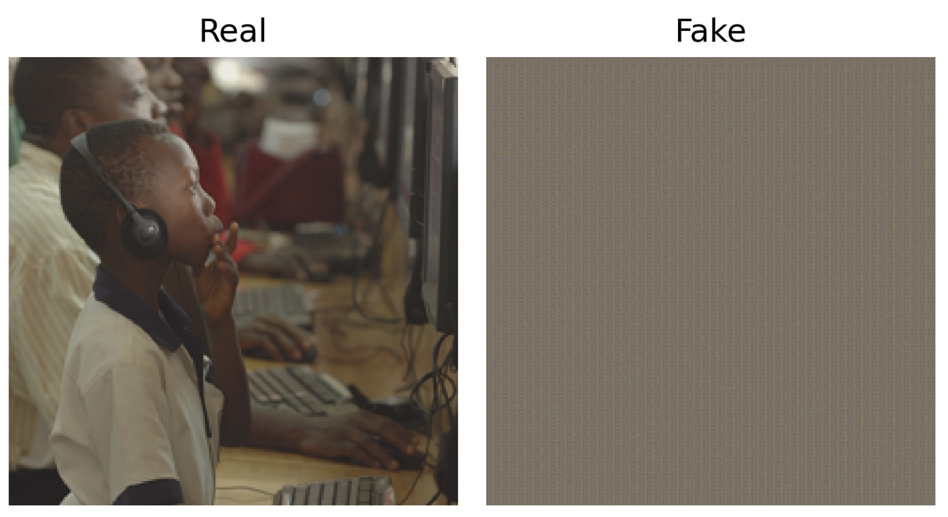
Notes:
GDP γερμανίας 4.4 trillion.

Slide 22
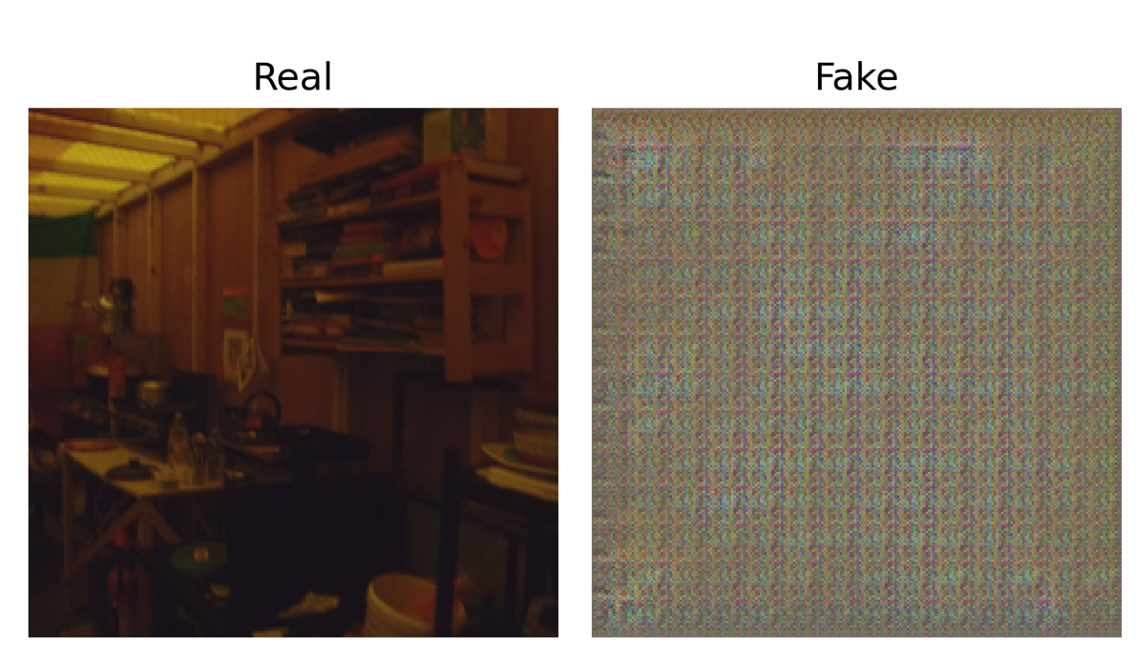
Notes:
GDP γερμανίας 4.4 trillion.

Slide 23
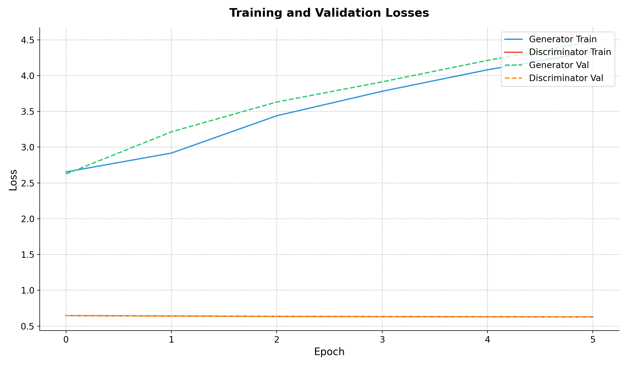
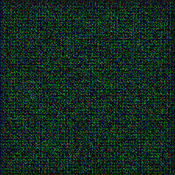
Notes:
GDP γερμανίας 4.4 trillion.

Slide 24
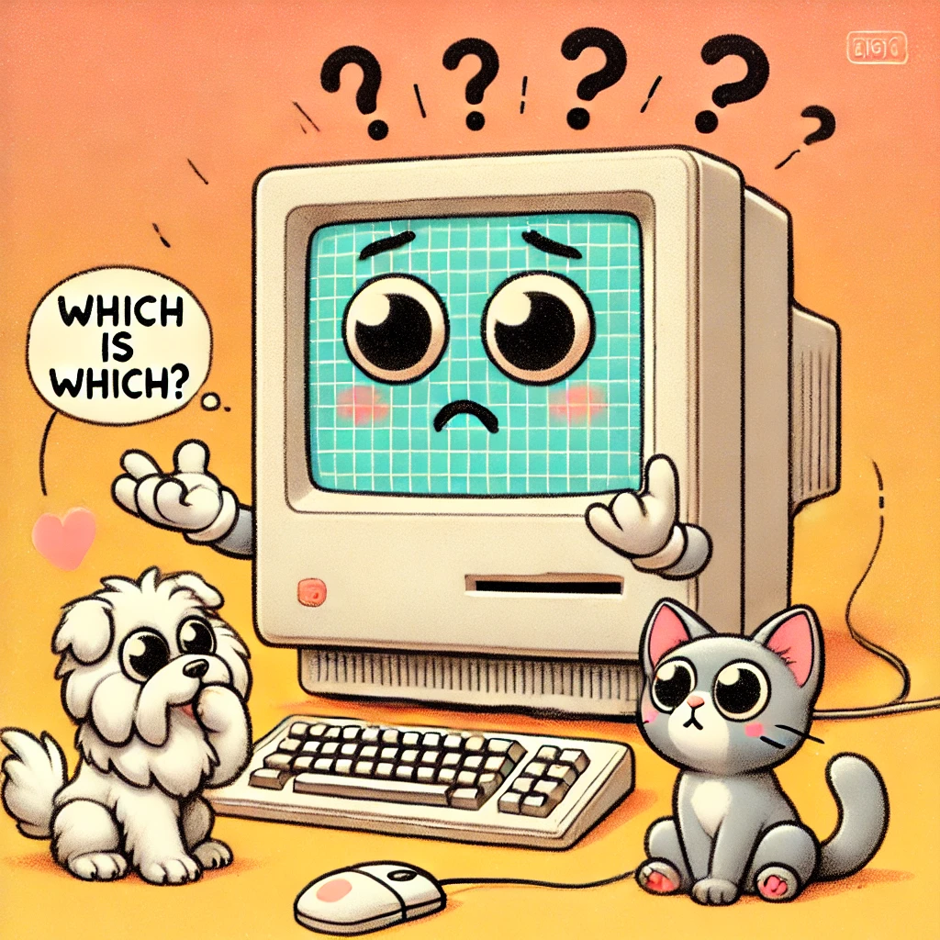
Notes:
GDP γερμανίας 4.4 trillion.

Slide 25

Thanks!
Do you have any questions?
aid25002@uom.edu.gr
aid25006@uom.edu.gr
Notes:
Created by DALL-E

Slide 26
Rerefences
Böhm, J. (2021, February 2). *A simple explanation of the Inception Score*. Octavian. Retrieved January 10, 2025, from https://medium.com/octavian-ai/a-simple-explanation-of-the-inception-score-372dff6a8c7a
Fradet, N. (2023, February 18). *CLIP: Why and how it works* (for text-to-image generation). Nathan Fradet. Retrieved November 15, 2024, from https://nathanfradet.com/posts/text-to-image/
Fréchet, M. (2017, October 25). *The role of ImageNet classes in Fréchet Inception Distance* [Conference session]. ICLR 2018, Vancouver, BC, Canada. Retrieved November 23, 2024, from https://slideslive.com/38998637/the-role-of-imagenet-classes-in-frechet-inception-distance
He, K., Zhang, X., Ren, S., & Sun, J. (2016). Deep residual learning for image recognition. In *Proceedings of the IEEE conference on computer vision and pattern recognition* (pp. 770-778). Retrieved December 1, 2024, from [https://openaccess.thecvf.com/content_cvpr_2016/papers/He_Deep_Residual_Learning_CVPR_2016_paper.pdf](https://openaccess.thecvf.com/content_cvpr_2016/papers/He_Deep_Residual_Learning_CVPR_2016_paper.pdf)
Radford, A., Metz, L., & Chintala, S. (2015). Unsupervised representation learning with deep convolutional generative adversarial networks. *arXiv preprint arXiv:1511.06434*. Retrieved December 18, 2024, from [https://arxiv.org/pdf/1511.06434.pdf](https://arxiv.org/pdf/1511.06434.pdf)
Vaswani, A., Shazeer, N., Parmar, N., Uszkoreit, J., Jones, L., Gomez, A. N., ... & Polosukhin, I. (2017). Attention is all you need. In *Advances in neural information processing systems* (Vol. 30). Retrieved December 26, 2024, from [https://proceedings.neurips.cc/paper/2017/file/3f5ee243547dee91fbd053c1c4a845aa-Paper.pdf](https://proceedings.neurips.cc/paper/2017/file/3f5ee243547dee91fbd053c1c4a845aa-Paper.pdf)
Zhang, H., Xu, T., Li, H., Zhang, S., Wang, X., & Huang, X. (2017). Stackgan: Text to photo-realistic image synthesis with stacked generative adversarial networks. In *Proceedings of the IEEE international conference on computer vision* (pp. 5907-5915). Retrieved January 10, 2025, from [https://openaccess.thecvf.com/content_ICCV_2017/papers/Zhang_StackGAN_Text_to_ICCV_2017_paper.pdf](https://openaccess.thecvf.com/content_ICCV_2017/papers/Zhang_StackGAN_Text_to_ICCV_2017_paper.pdf)

